Slide 1
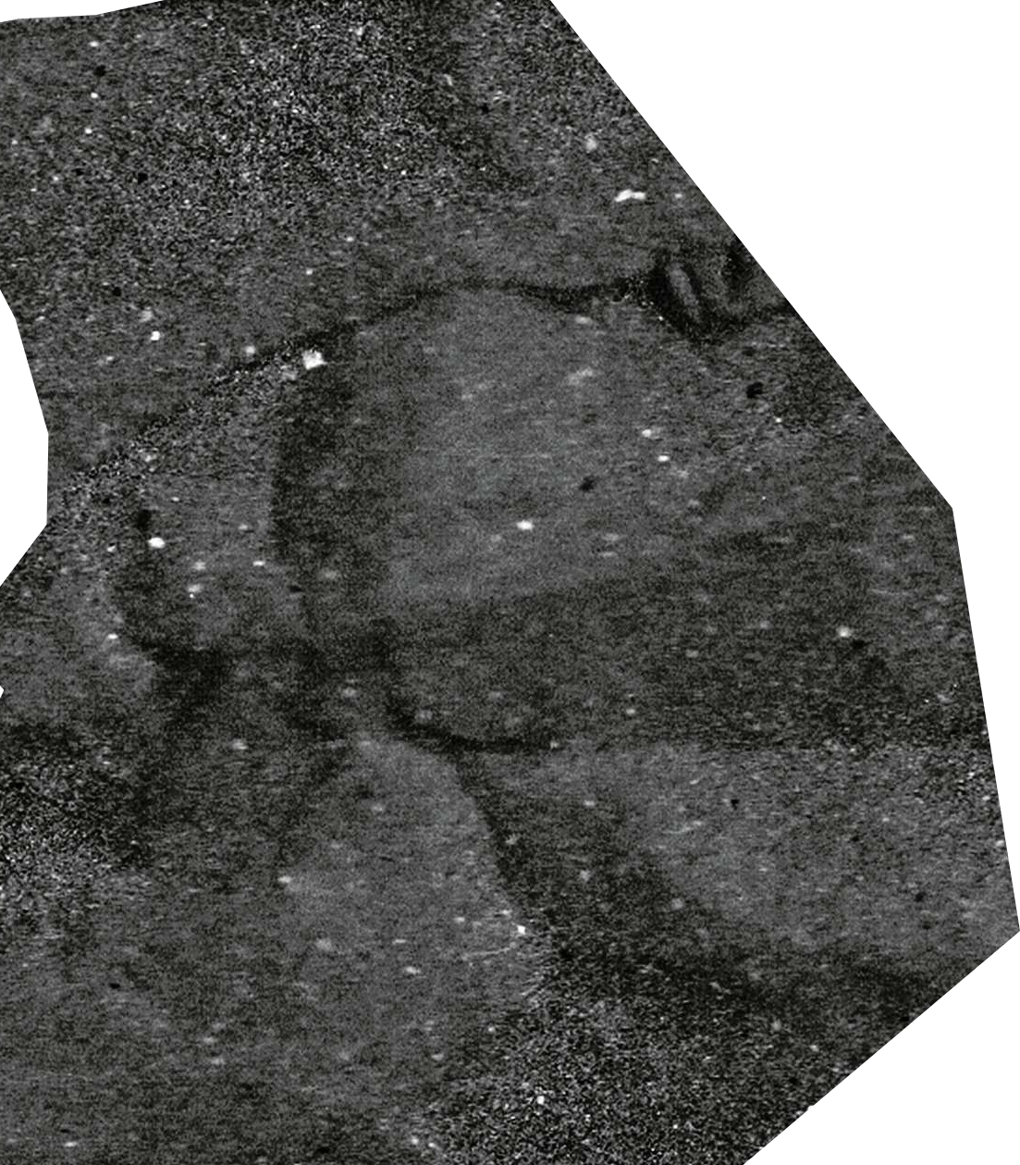
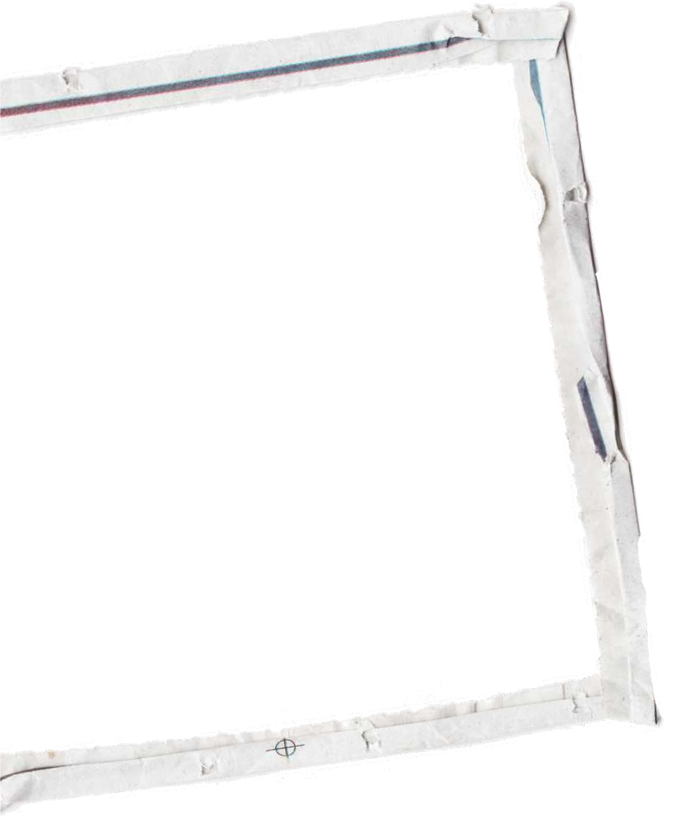

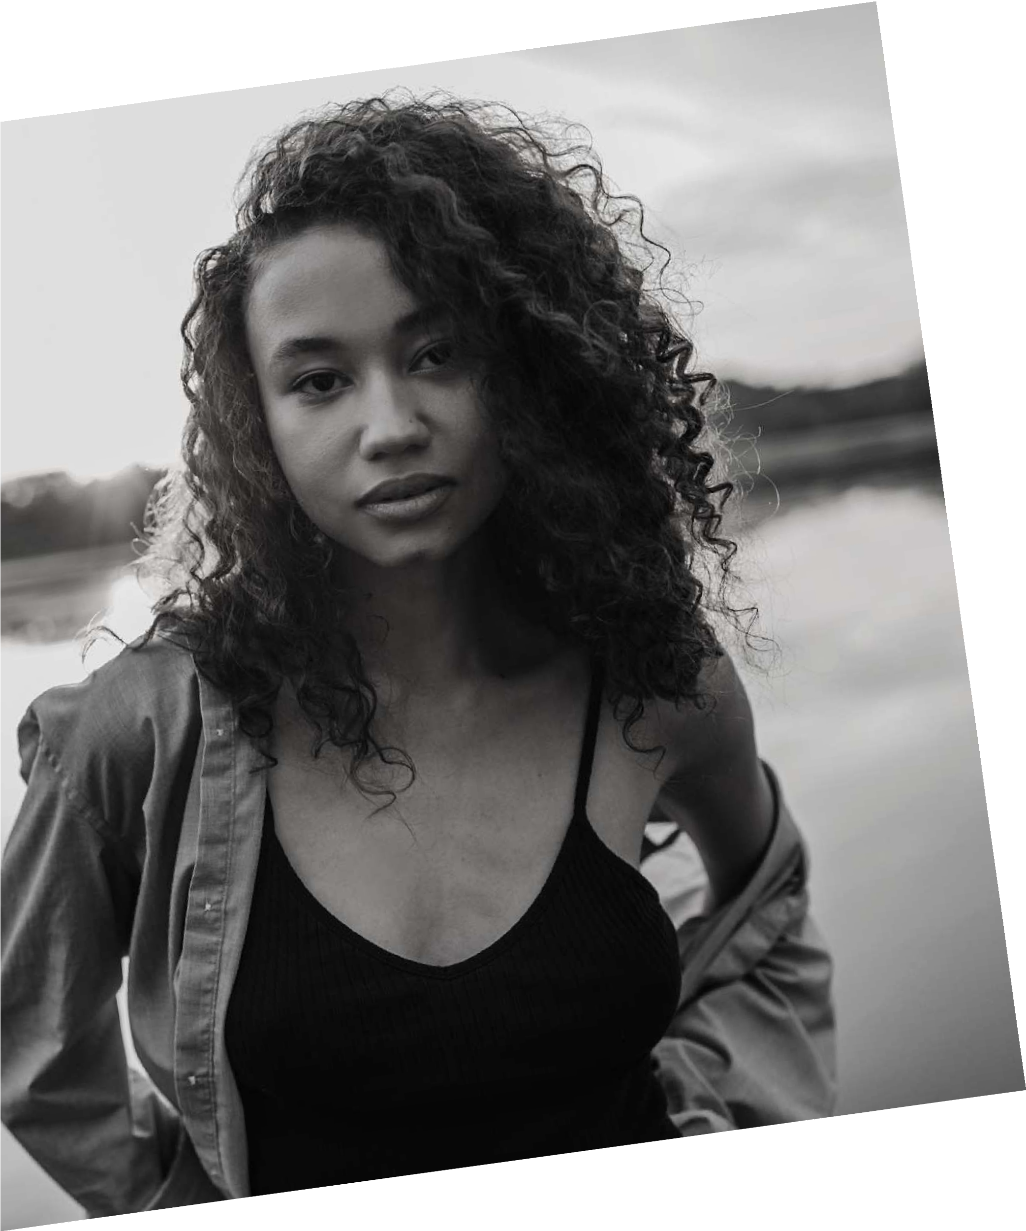


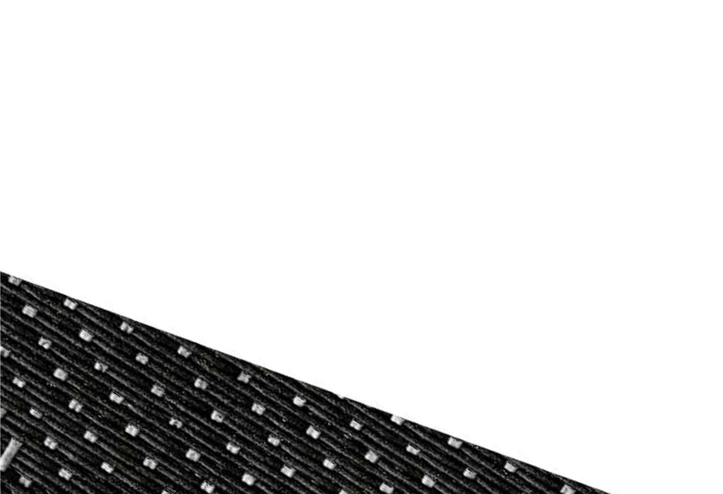

HOMEMADE
PORTFOLIO
The important thing is to see
what is invisible to others

Slide 2


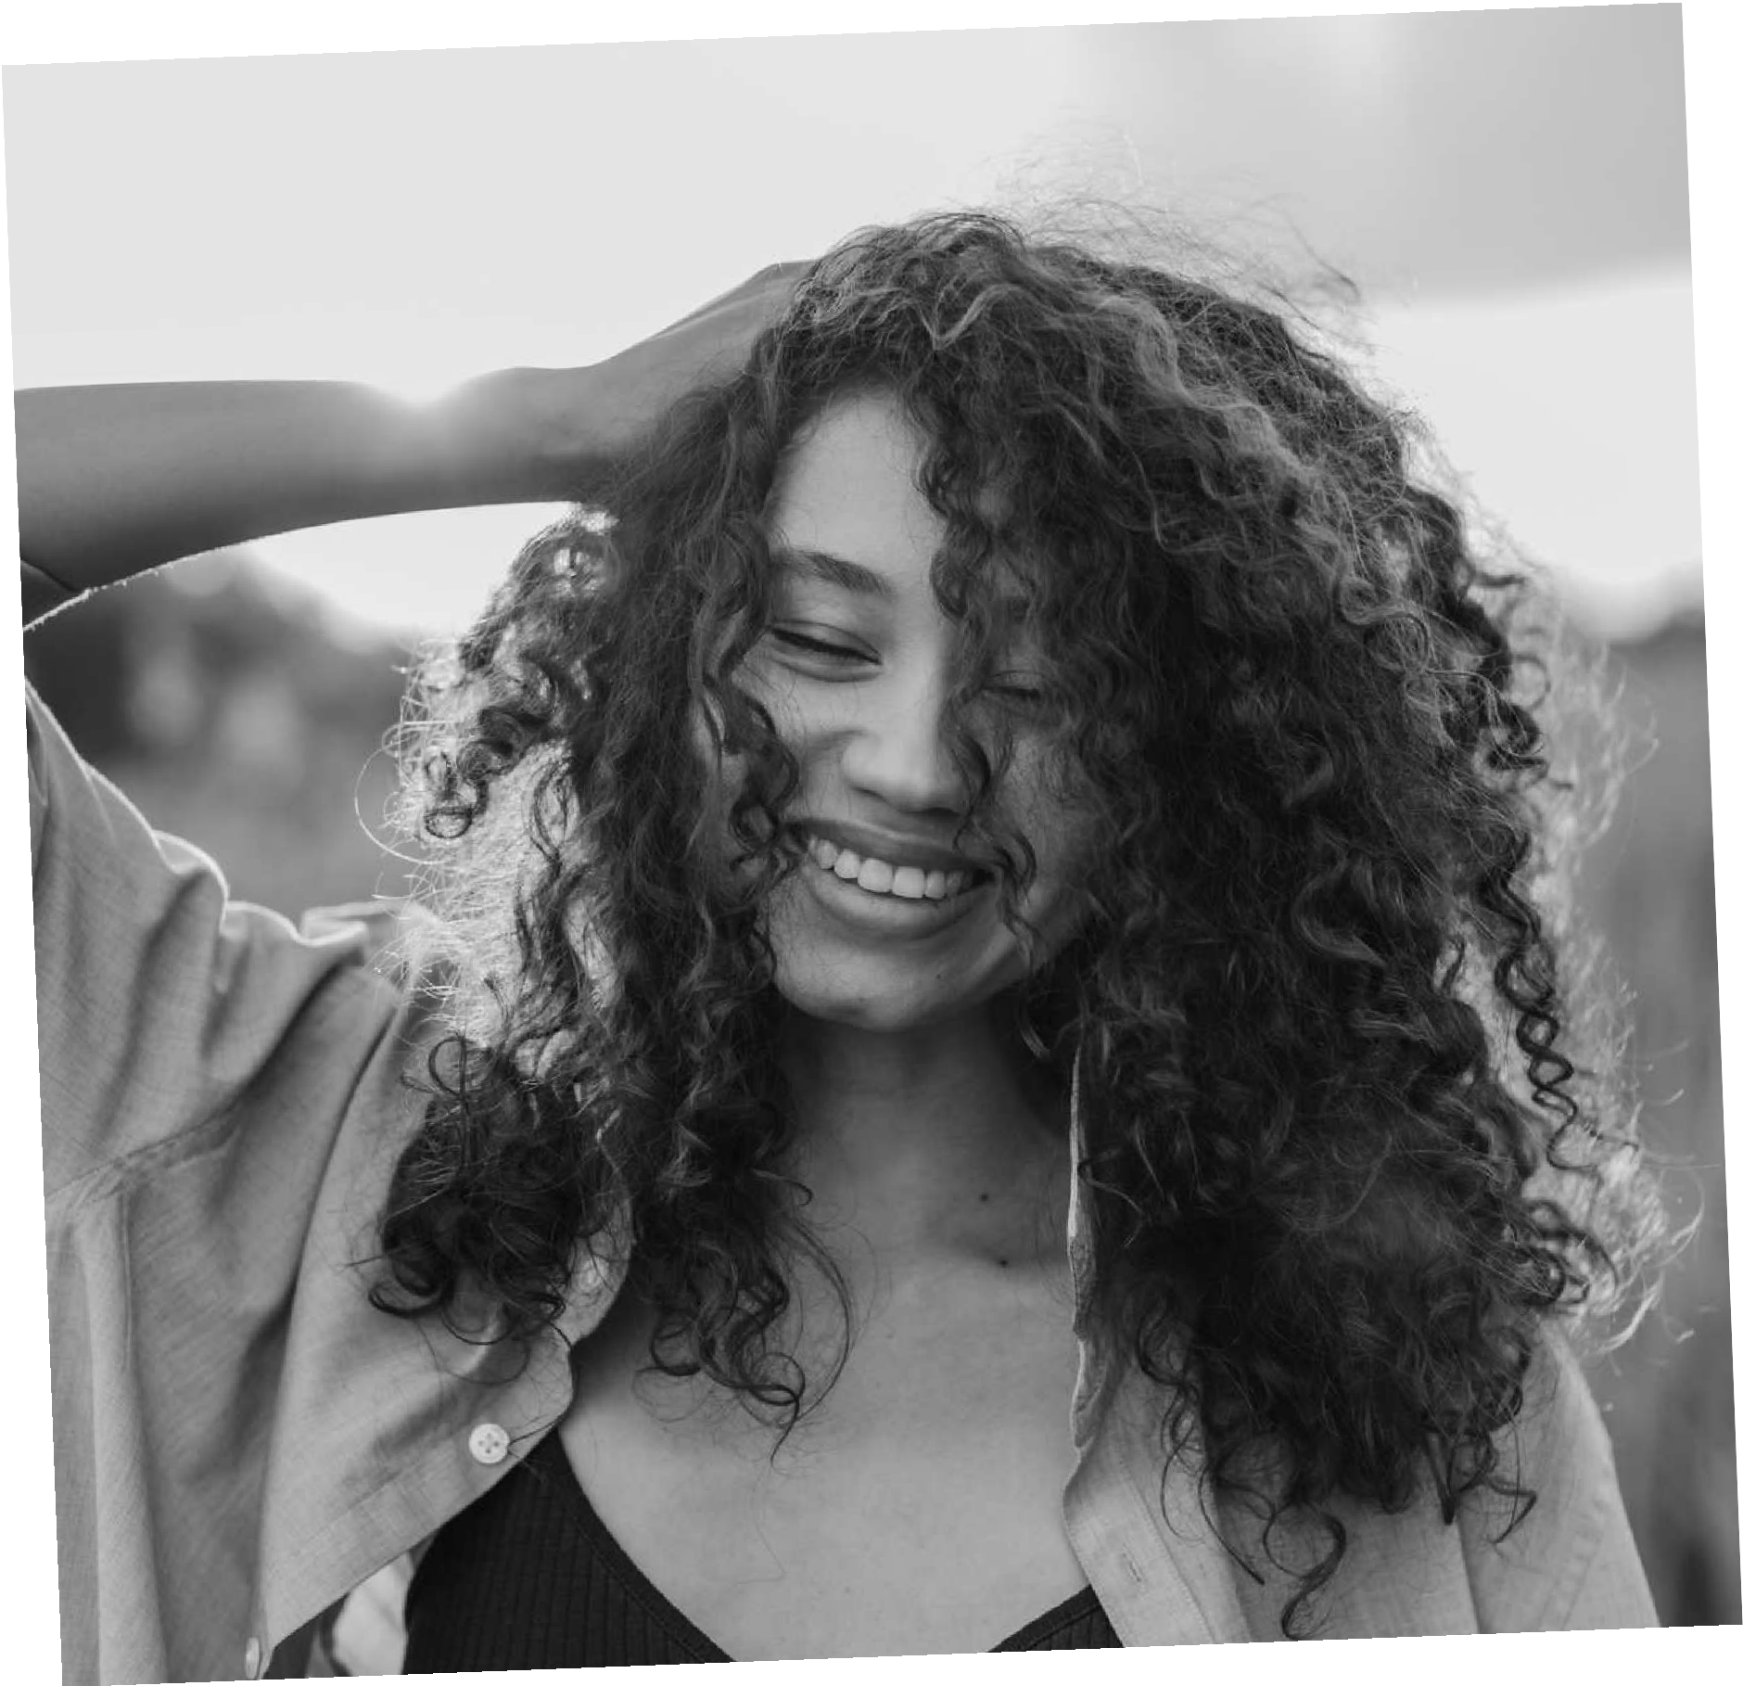
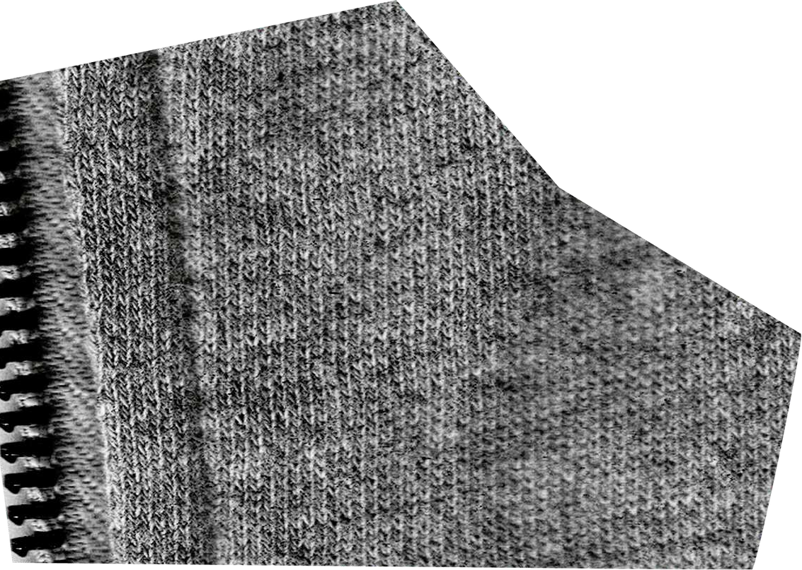
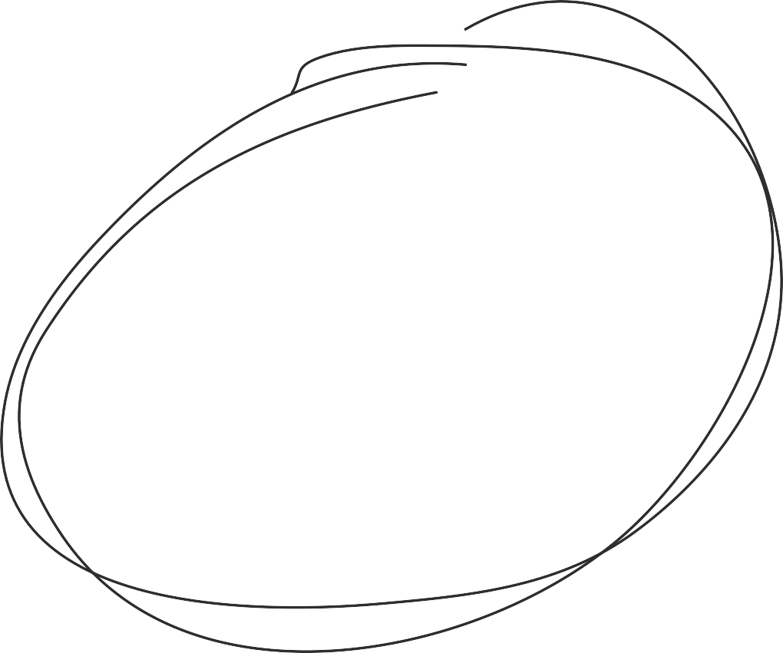
PROBLEM
More and more people are approaching the world of photography, and in a world where portability is sought, it becomes necessary to be able to share one's work with others.
Amateur photographers especially cannot afford a site with which to show their shots.

Slide 3
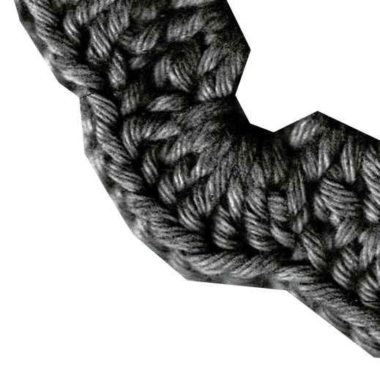

SOLUTION
Create a platform that offers amateur photographers a place to display and share their work without incurring additional costs.
Each user will have an area dedicated to them for managing their portfolio, they will be able to upload new photos with titles and captions of their choice, delete them and share them.
You can search for the photo by title or author and visit their portfolio.

Slide 4
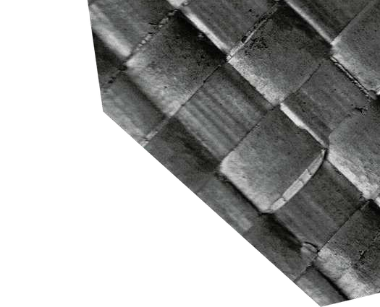
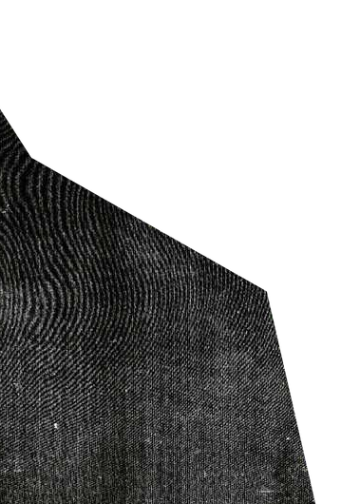
THANK YOU FOR YOUR ATTENTION
Stanislao Aquilante 0124002538 Federico Maglione 0124002605 Lorenzo Virano 0124002536

